Slide 1
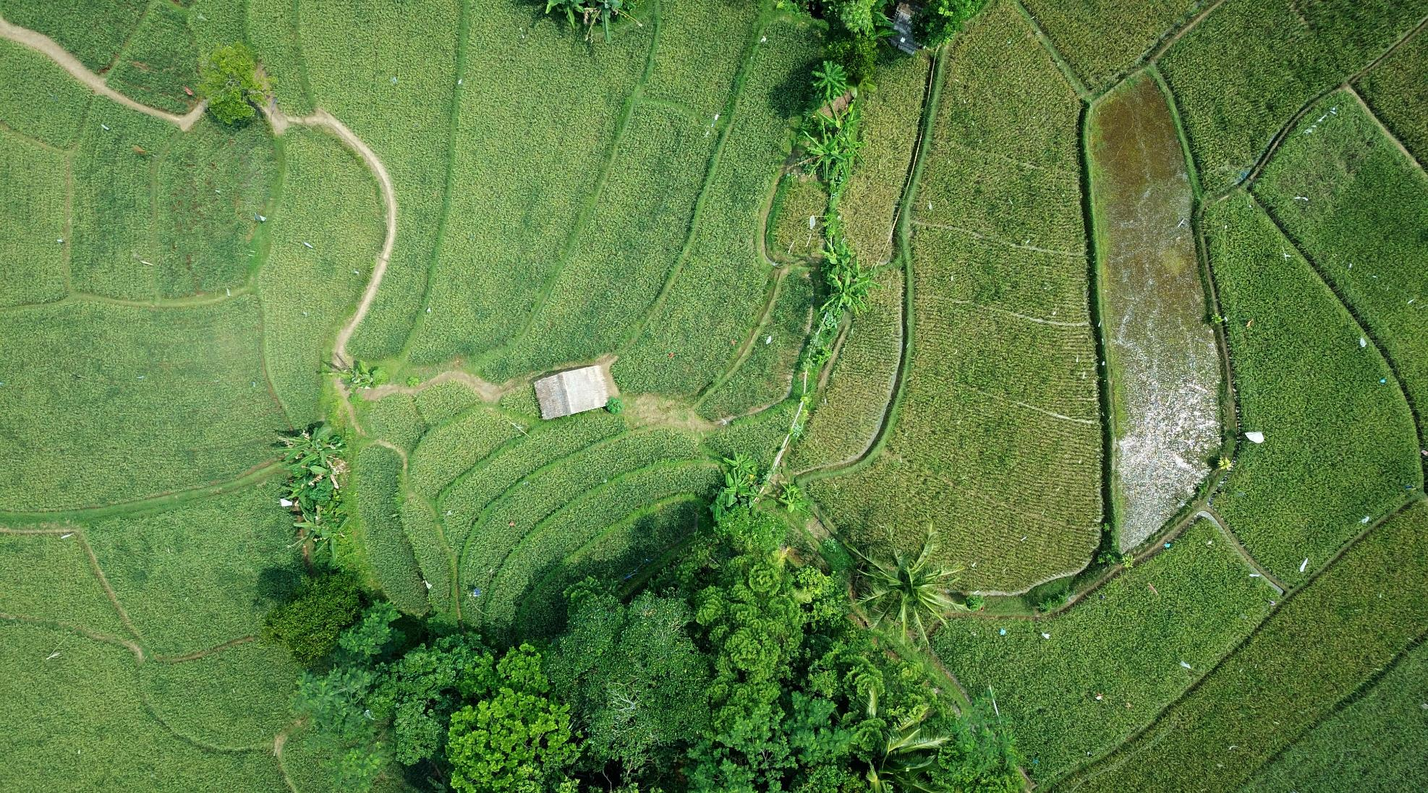
Monitoring Vegetation Cover Using Satellite Data
Demonstration Project by Aakriti Sinha

Slide 2
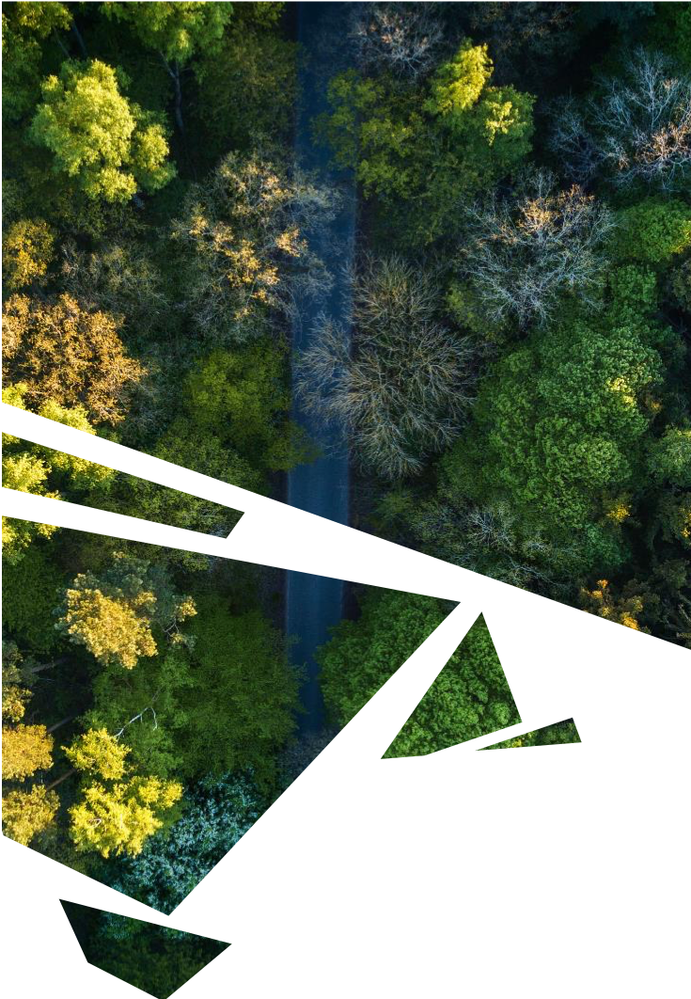
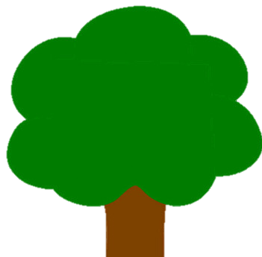

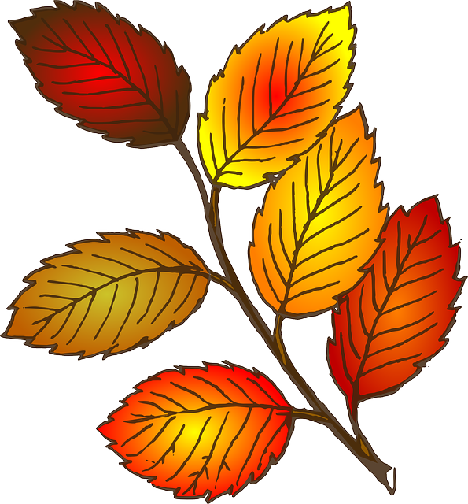
Objective
Monitor Vegetation Cover
Use satellite data to inspect the changes in vegetation health and density of an area of interest over a specific period of time

Slide 3
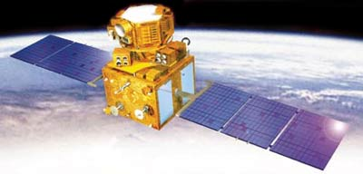

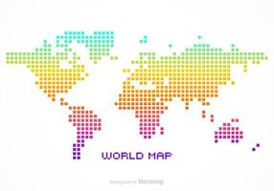

Satellite Data
Resourcesat-1
Sensor LISS-III
Bhuvan’s Open Data Archive
Spatial Resolution: 24m
Degrees: 0.000225 deg
Calculated: (0.000225 * 111*1000)m = 24.975m
Reference
Number of Bands: 4
3 spectral bands in VNIR and 1 band in SWIR
B2 (Green), B3(Red), B4(NIR), B5(SWIR)
Reference

Slide 4
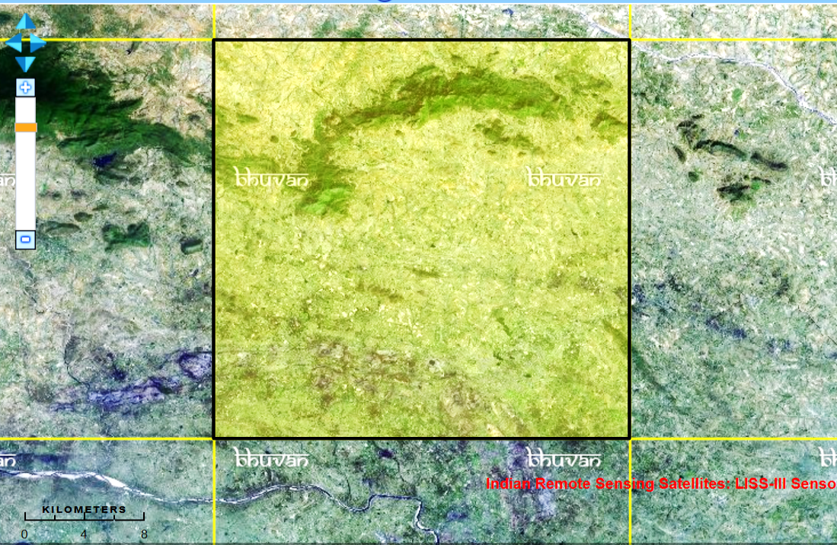
Area of Interest
Dhanbad, Surrounding Urban Areas and Northwestern Region
Dhanbad (Long, Lat): 86.43E, 23.79N
Total area covered: 27.672 km by 27.672 km
765.74 sq.km
Single Tile (Longitude, Latitude)
Upper left: X = 86.25E, Y = 24N Upper right: X = 86.5E, Y = 24N
Lower left: X = 86.25E, Y = 23.75N Lower right: X = 86.5E, Y = 23.75N

Slide 5
Time Period
2009
2010
2011
2012
2013

Slide 6
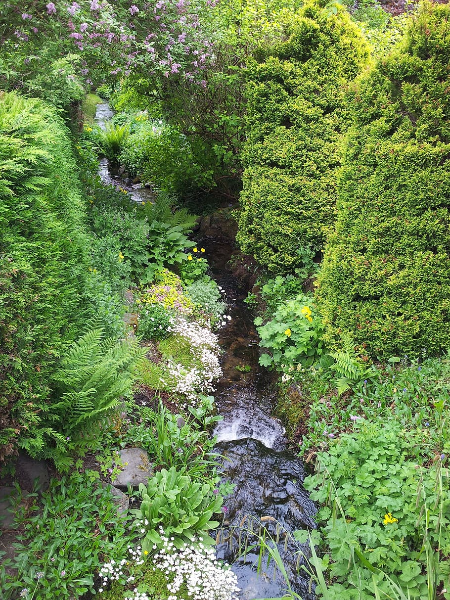
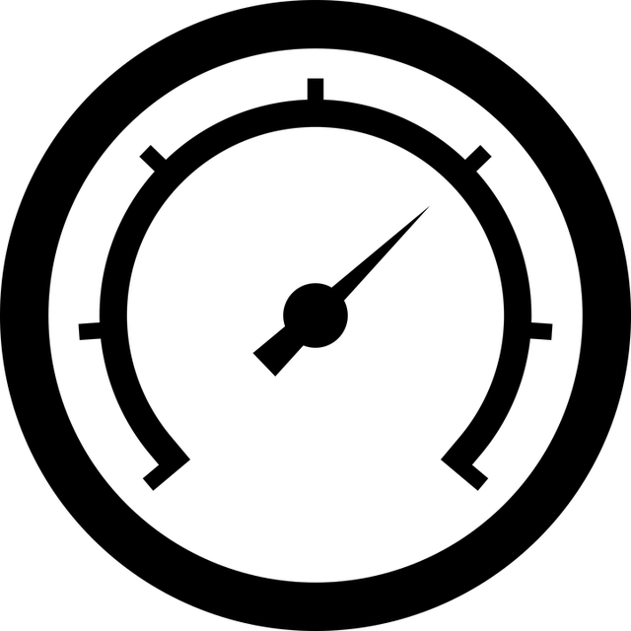

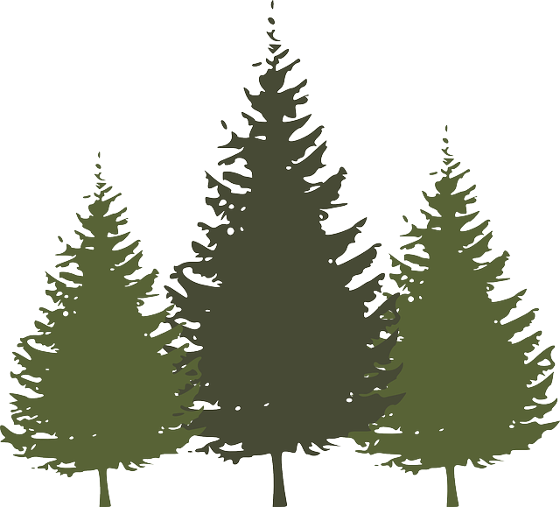
Measuring Vegetation
NDVI
Normalized Difference Vegetation Index
(NIR + R)/(NIR + R)
Vegetation Health
< 0 : Inanimate Objects
0.2 – 0.33: Unhealthy plants
0.33 – 0.66: Moderately healthy plants
> 0.66: Very healthy plants
Vegetation Density
0.1 – 0.2: Bare soil
0.2 – 0.5: Sparse Vegetation
> 0.5: Dense vegetation
Reference

Slide 7
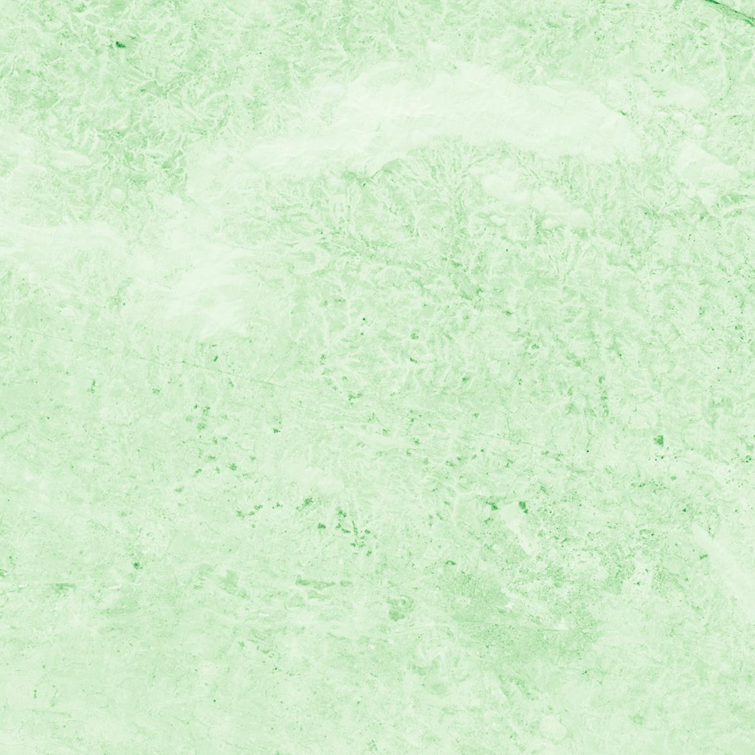
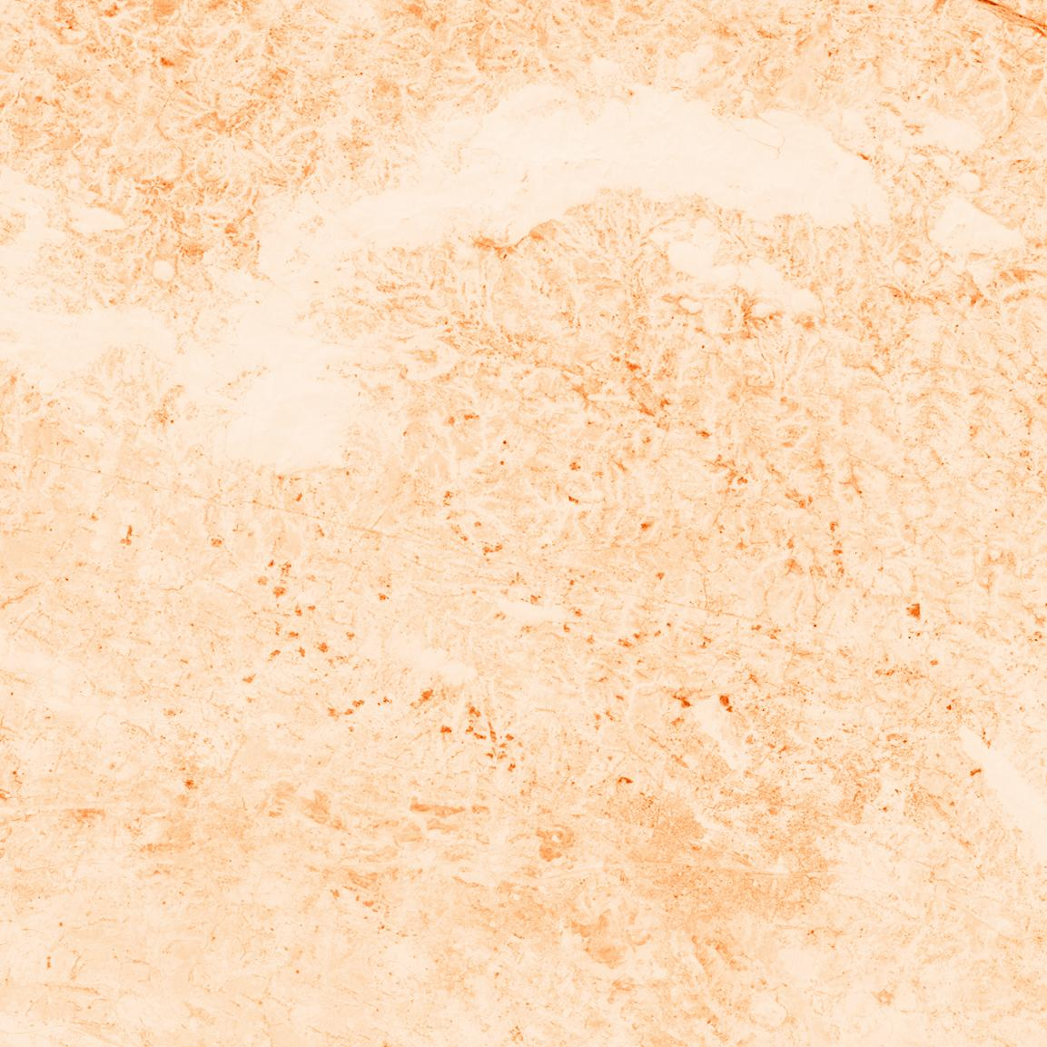
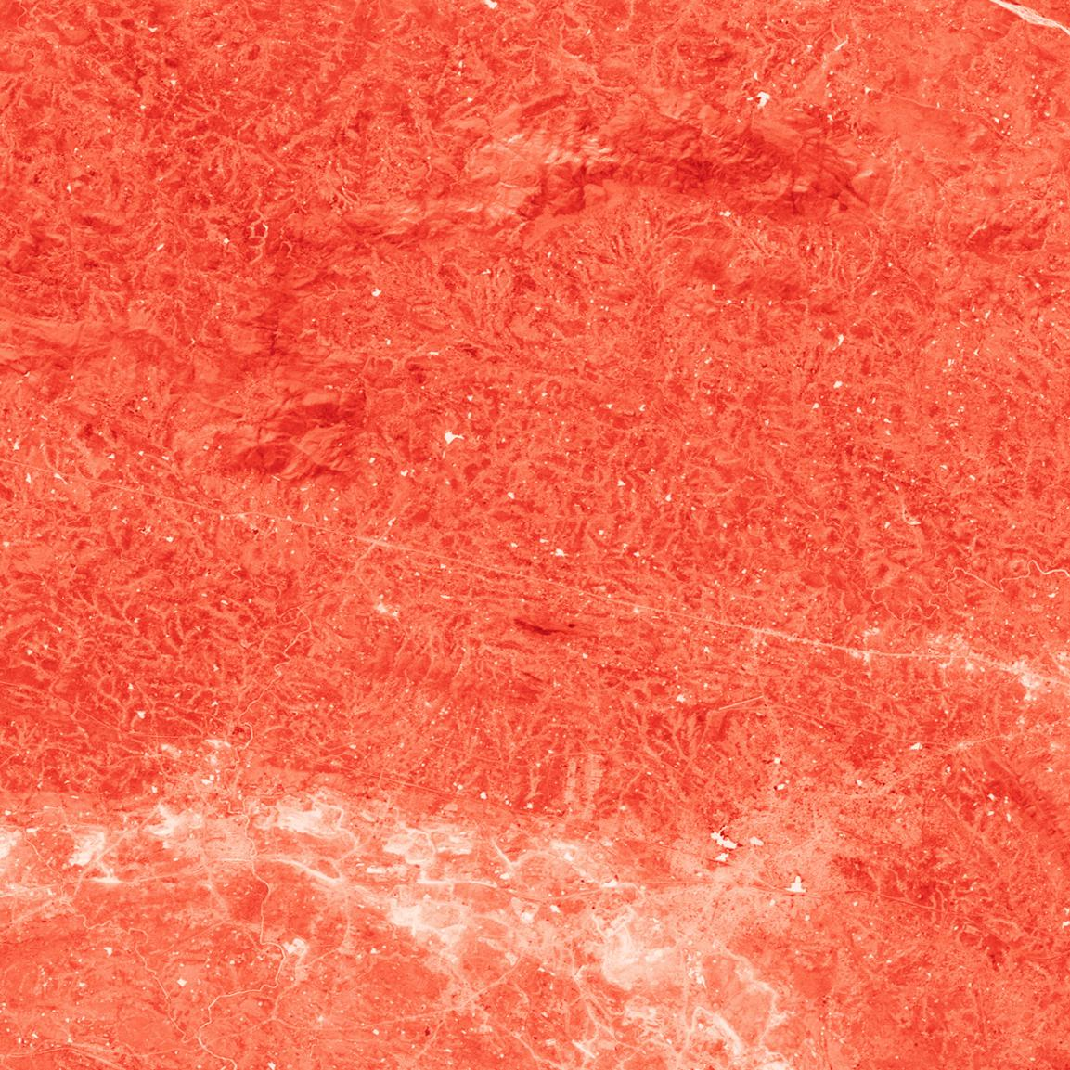
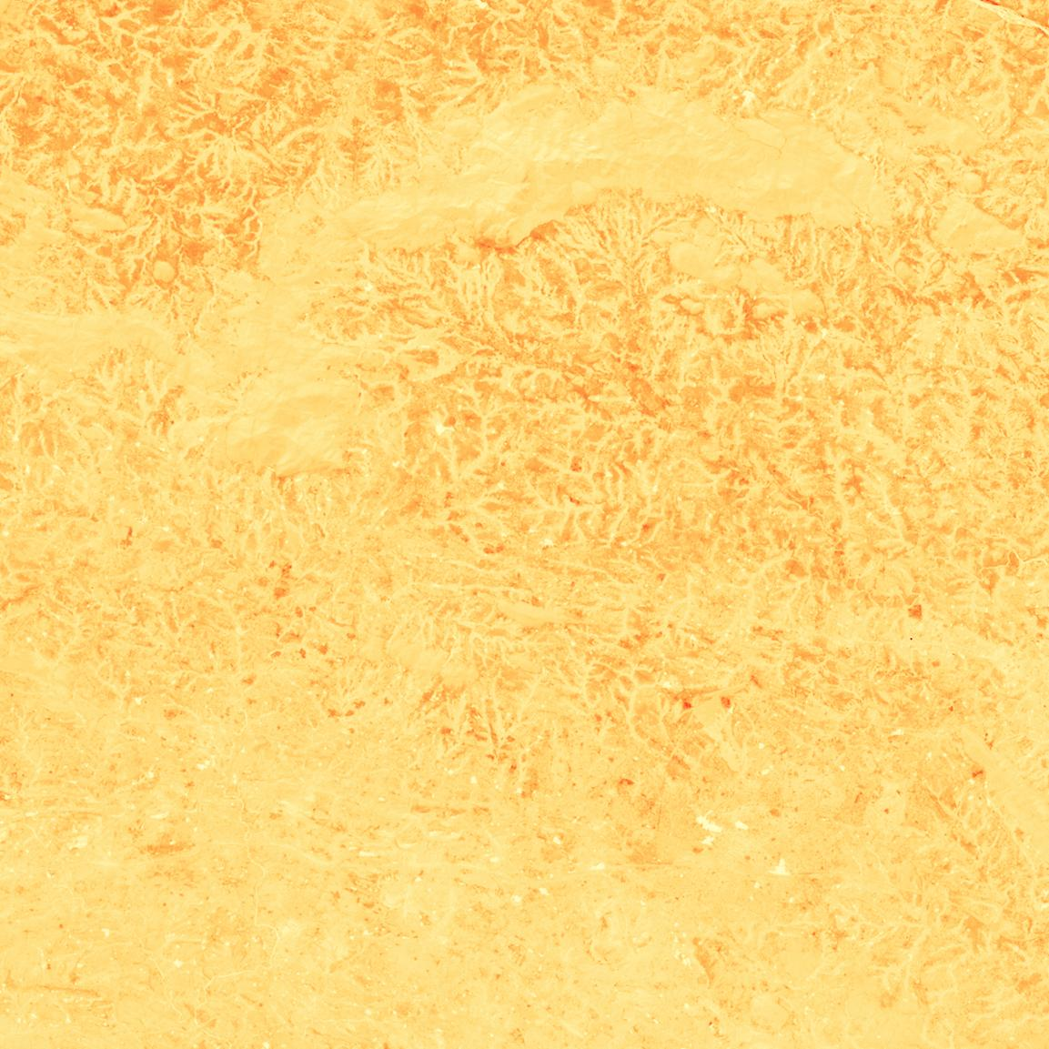
B2
B3
A look through LISS-III eyes
The image obtained in each spectral band
B2: Green
B3: Red
B4: NIR
B5: SWIR
B4
B5

Slide 8
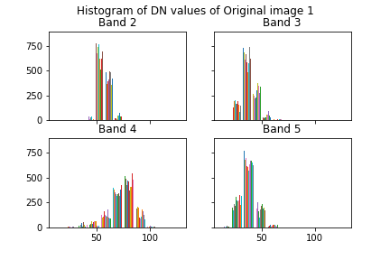
Inspecting the DN Value Distribution
DN values are concentrated over a small portion of the total range of values (0-255) in Band 2, 3, and 5.
Low contrast and lesser differentiation of features.

Slide 9
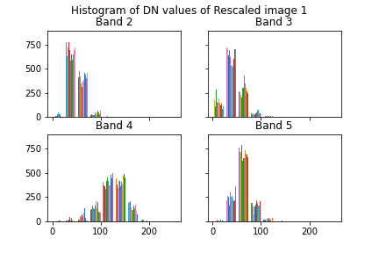
DN Value Distribution after Correction
Rescaling with Linear Stretch
Complete range of DN values (0-255) utilized
Better contrast and differentiation of features

Slide 10
B2
B3
Corrected Images
The image obtained in each spectral band
B2: Green
B3: Red
B4: NIR
B5: SWIR
B4
B5

Slide 11
Combined Image with Location Markers
Standard False Colour Composite
R G B
| | |
V V V
NIR Red Green
Red colour signifies vegetation. Denser the vegetation, darker the tone.
Greys signify urban areas, roads and rivers.

Slide 12
Vegetation Health on 20 October 2009
Green: Very Healthy Vegetation
Yellow: Moderately Healthy Vegetation
Red: Unhealthy Vegetation/Urban Features/River
Matching with true colour images shows that the large green area corresponds to hilly regions. The large red area corresponds to urban areas.

Slide 13
20 October 2009
09 December 2011
Vegetation Health Over Time
The changes in vegetation health are clearly visible.
19 February 2012
09 March 2013

Slide 14
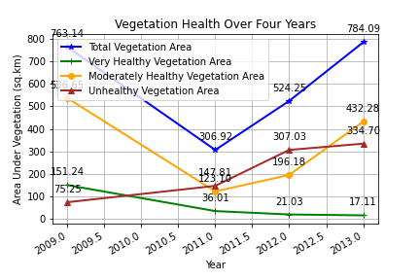
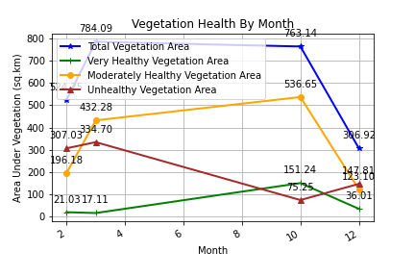
Change in Vegetation Health

Slide 15
Vegetation Density on 20 October 2009
Green: Dense Vegetation
Yellow: Sparse Vegetation
Red: No Vegetation (Urban features, River)
Matching with true colour images shows that the large green area corresponds to hilly regions. The large red area corresponds to urban areas.

Slide 16
20 October 2009
09 December 2011
Vegetation Density Over Time
The changes in vegetation density are clearly visible.
19 February 2012
09 March 2013

Slide 17
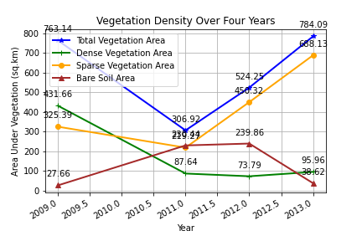
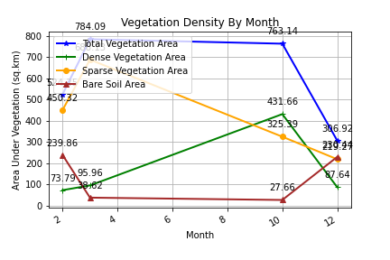
Change in Vegetation Density

Slide 18
All analysis and visualization done in Python 3 (GitHub Repo)
Get metadata
#Loop through each image
for image_number in range(1,total_images+1):
#Get metadata
# create element tree object
for xmlfile in glob.iglob(f_getFilePath(f'data/*_Image{image_number}/*.xml')):
tree = ET.parse(xmlfile)
# get root element
root = tree.getroot()
#iterate through metadata
for image_data in root.findall('For_Image_Data'):
print(image_data)
for desc_item in image_data:
print(desc_item)
if desc_item.tag == "Date_of_Pass":
image_date.append(desc_item.text)
elif desc_item.tag == 'Spatial_Resolution':
spatial_resolution_deg.append(float(desc_item.text.split()[0]))
else:
continue
Inspect Raw Image
#Inspect original image and make histogram
band_number = 2
hfig, hax = plt.subplots(2,2,sharex=True,sharey=True)
hax = hax.ravel()
for filepath in glob.iglob(f_getFilePath(f'data/*_Image{image_number}/*.tif*')):
# print(filepath)
image_iBand = imageio.imread(filepath)
cmap = f_chooseColourMap(band_number)
plt.imsave(f_getFilePath(f"reports/OriginalInColour/
Image{image_number}_Band{band_number}.jpg"), image_iBand, cmap=cmap)
print(f"\nInspect Original Image {image_number} in Band {band_number}...")
hfig, hax = f_plotHistogram(hfig,hax,image_iBand, band_number, image_number)
band_number = band_number + 1
hfig.suptitle(f"Histogram of DN values of Original image {image_number}")
hfig.subplots_adjust(top=0.88)
plt.savefig(f_getFilePath(f"reports/histograms/OriginalImage_{image_number}"))
Process and Correct Image
#Function to process image
def f_processImage(image, band_number, image_number, hfig, hax, cmap):
#Contrast Stretching
image_contrast_rescale = exposure.rescale_intensity(image, in_range='image')
plt.imsave(f_getFilePath(f"reports/Rescale/
Image{image_number}_Band{band_number}.tiff"), image_contrast_rescale, cmap=cmap)
#Histogram of DNs
hfig,hax = f_plotHistogram(hfig, hax, image_contrast_rescale, band_number, image_number)
return(image_contrast_rescale, hfig, hax)
Generate False Colour Composite Image
#Create False COlour Composite Image
green_band = Image.fromarray(np.uint8(processed_image_list[0]))
red_band = Image.fromarray(np.uint8(processed_image_list[1]))
nir_band = Image.fromarray(np.uint8(processed_image_list[2]))
swir_band = Image.fromarray(np.uint8(processed_image_list[3]))
new_image_RGB = Image.merge('RGB',(nir_band,red_band,green_band))
#Mark locations
new_image_RGB = f_markLocations(new_image_RGB)
new_image_RGB.save(f_getFilePath(f"reports/CompositeImage/Image{image_number}_FCC_RGB.tiff"))

Slide 19
All analysis and visualization done in Python 3 (Contd) (GitHub Repo)
Calculate NDVI
#NDVI: Normalized Difference Vegetation Index: (NIR-R)/(NIR+R)
# Allow division by zero
np.seterr(divide='ignore', invalid='ignore')
# Calculate NDVI
ndvi_arr = (processed_image_list[2].astype(float) –
processed_image_list[1].astype(float)) /
(processed_image_list[2] + processed_image_list[1])
ndvi_green_arr = ndvi_arr
ndvi_green_arr[ndvi_green_arr < 0.33] = 0
print(ndvi_green_arr.shape)
ndvi_green = Image.fromarray(np.uint8(ndvi_green_arr*255))
plt.imsave(f_getFilePath(f"reports/CompositeImage/
Image{image_number}_ndvi_green_vegetation.tiff"),
ndvi_green,cmap="RdYlGn")
Calculate Area Under Vegetation
#Calculate area under vegetation
spatial_resolution = spatial_resolution_deg[image_number - 1]*111*1000
pixel_area = (spatial_resolution*spatial_resolution)/1000000
#Total vegetation area
total_vegetation_area = np.count_nonzero(ndvi_green_arr > 0) *pixel_area
#Dense vegetation area
dense_vegetation_area = np.count_nonzero(ndvi_green_arr > 0.66) *pixel_area
#Sparse vegetation area
sparse_vegetation_area = np.count_nonzero((ndvi_green_arr < 0.66) & (ndvi_green_arr > 0.33)) *pixel_area
#Add to list of vegetation area by date
dense_vegetation_area_list.append(dense_vegetation_area)
sparse_vegetation_area_list.append(sparse_vegetation_area)
total_vegetation_area_list.append(total_vegetation_area)
#Percentage of vegetation
percentage_total_vegetation = (total_vegetation_area/(ndvi_green_arr.size*pixel_area))*100
Place data in Pandas dataframe
#Populate dataframe
df_vegetation['Date'] = image_date
df_vegetation['Total_Vegetation_Area'] = total_vegetation_area_list
df_vegetation['Dense_Vegetation_Area'] = dense_vegetation_area_list
df_vegetation['Sparse_Vegetation_Area'] = sparse_vegetation_area_list
#Convert date values to datetime format
df_vegetation["Date"] = pd.to_datetime(df_vegetation["Date"])
df_vegetation = df_vegetation.sort_values(by=["Date"])
#Save year and month as separate columns
df_vegetation["Year"] = pd.DatetimeIndex(df_vegetation["Date"]).year
df_vegetation["Month"] = pd.DatetimeIndex(df_vegetation["Date"]).month
Plot Vegetation Area
#Plot vegetation area by year
fig,ax = plt.subplots()
ax.plot(df_vegetation["Year"],df_vegetation['Total_Vegetation_Area'],label="Total Vegetation Area",
color='blue',marker='*',linewidth=2)
ax.plot(df_vegetation["Year"],df_vegetation['Dense_Vegetation_Area'],label="Dense Vegetation Area“
,color='green',marker='+',linewidth=2)
ax.plot(df_vegetation["Year"],df_vegetation['Sparse_Vegetation_Area'],label="Sparse Vegetation Area",
color='orange',marker='o',linewidth=2)
ax.set(xlabel="Year",ylabel="Area Under Vegetation (sq.km)",title="Vegetation Cover Over Four Years")
ax.legend(loc="upper left")
plt.setp(ax.get_xticklabels(), rotation=30, horizontalalignment='right')
fig.autofmt_xdate()
ax.grid()
plt.savefig(f_getFilePath("reports/Plots/VegetationByYearPlot"))
plt.show()

Slide 20
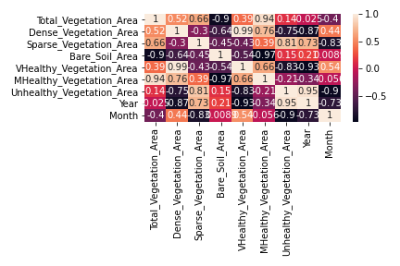
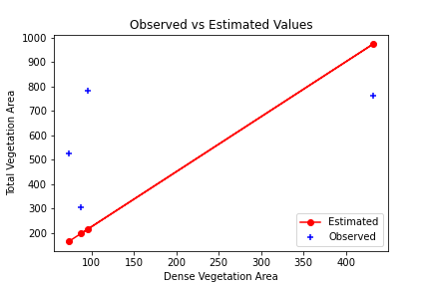
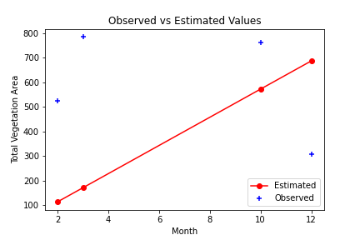
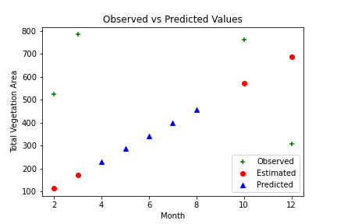
What more can be done?
This demo project has very little data. If more data is acquired, we can much more.
Correlation
Regression
Prediction
Cluster Identification
Change Monitoring

Slide 21
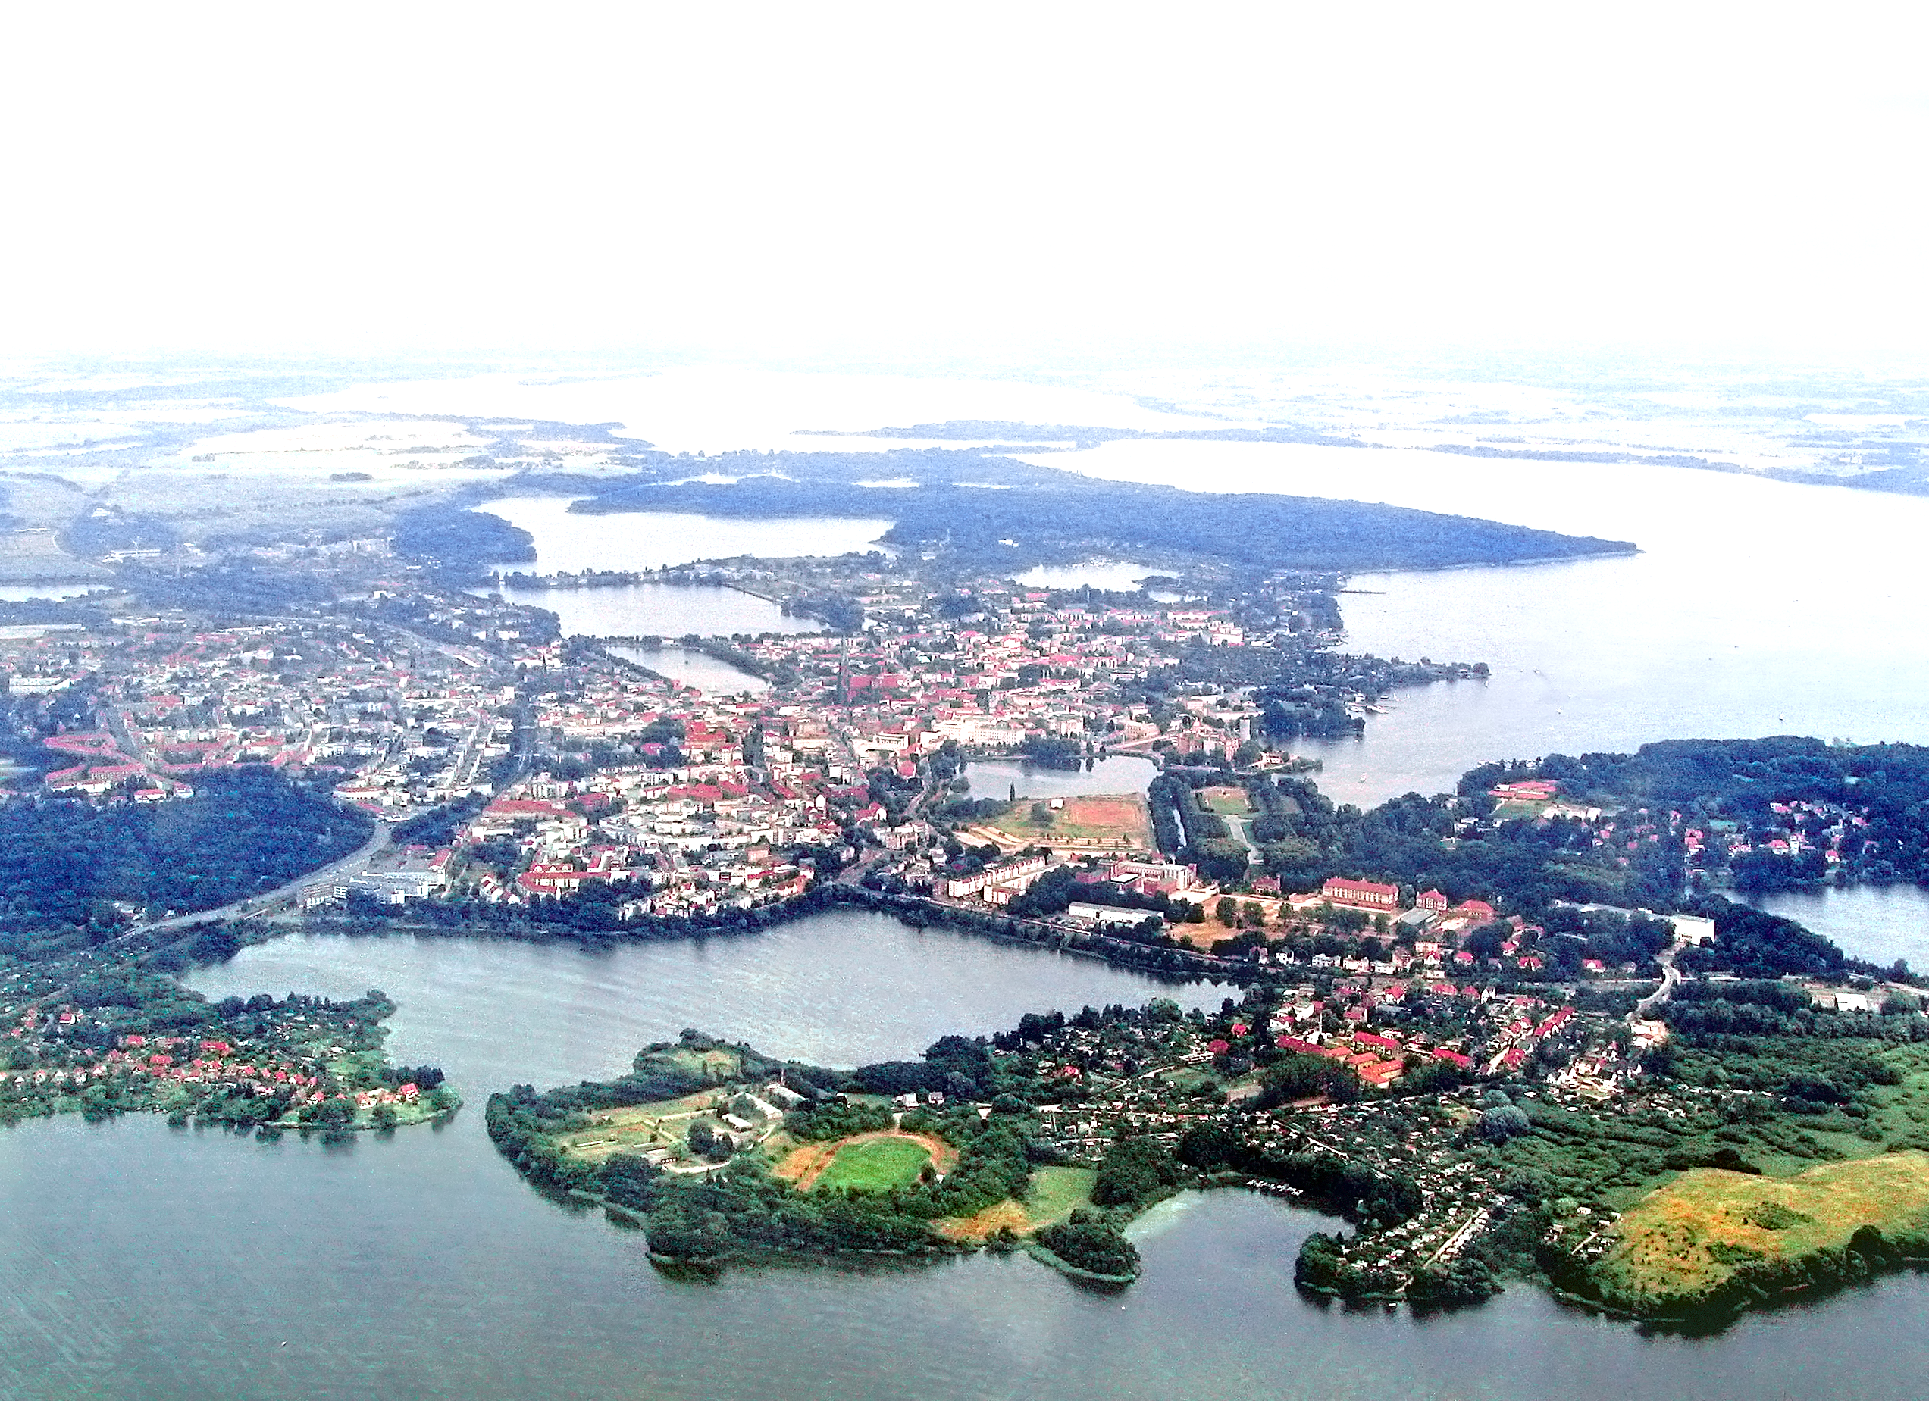
Summary
Satellite data can be used to monitor vegetation cover over any selected area
Using LISS-III data enables us to use NDVI Index
The minimum area covered is 27.7km by 27.7km
Obtaining a larger amount of data can help us find correlations of vegetation density with time periods.
Understand seasonal changes
Identify variations from regular seasonal density
This analysis can be used to:
Quantify performance of land reclamation projects in mining areas
Identify impact of human activity
Identify impact of climate change
A Useful Tool for Monitoring Vegetation Density

Slide 22
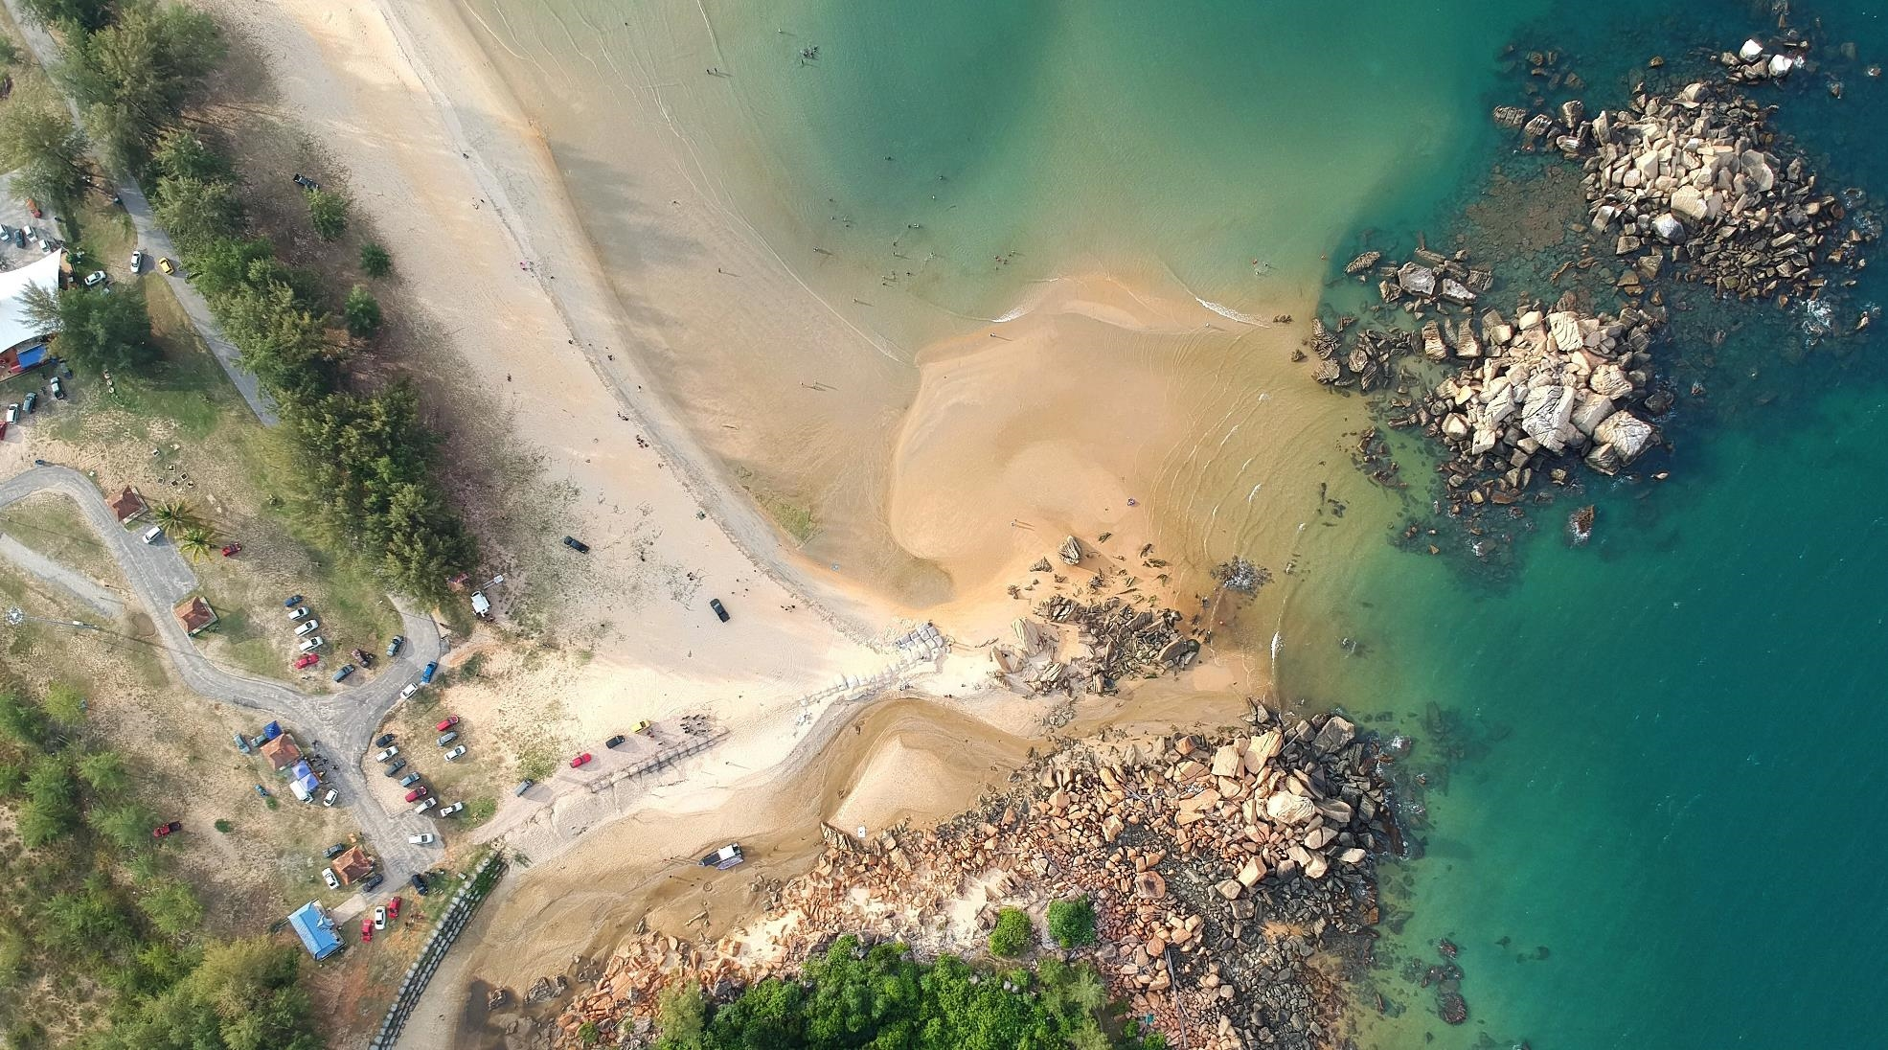
Thank You

